Slide 1
BELOW THE WATER LINE
Getting back to basics in high stakes SOF engagements

Slide 2
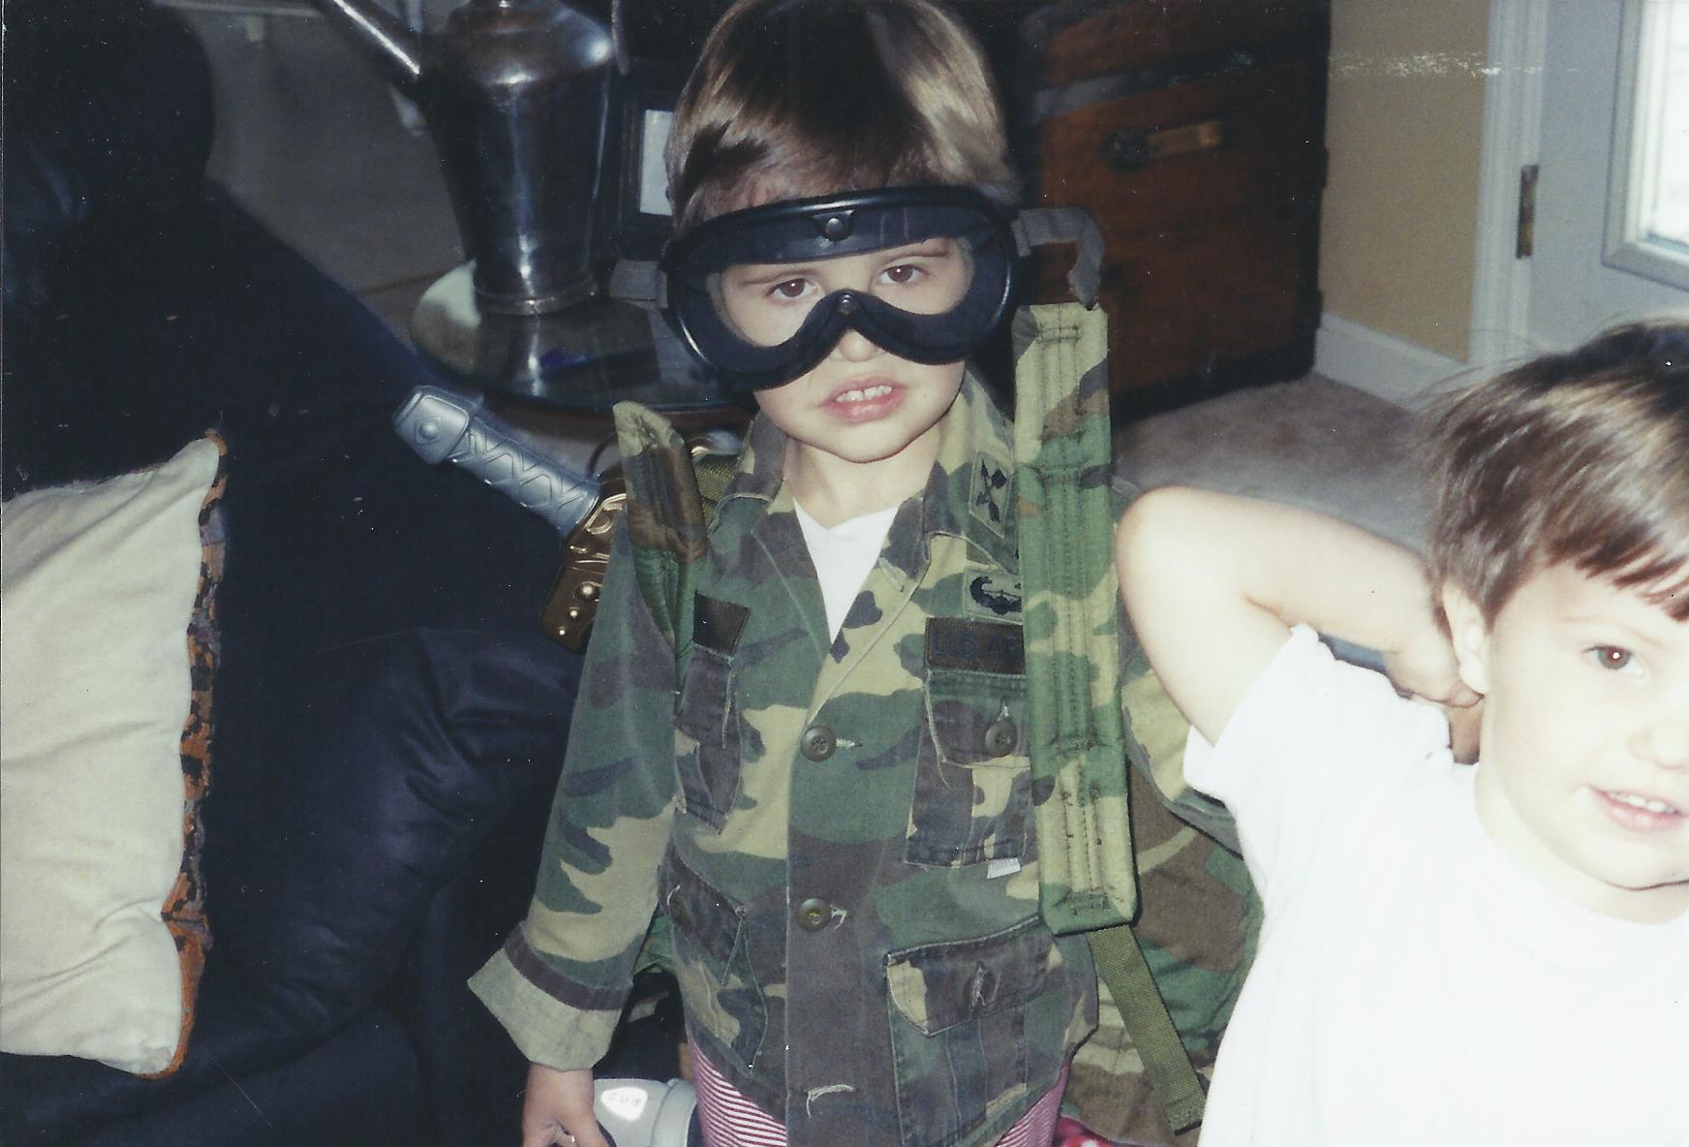
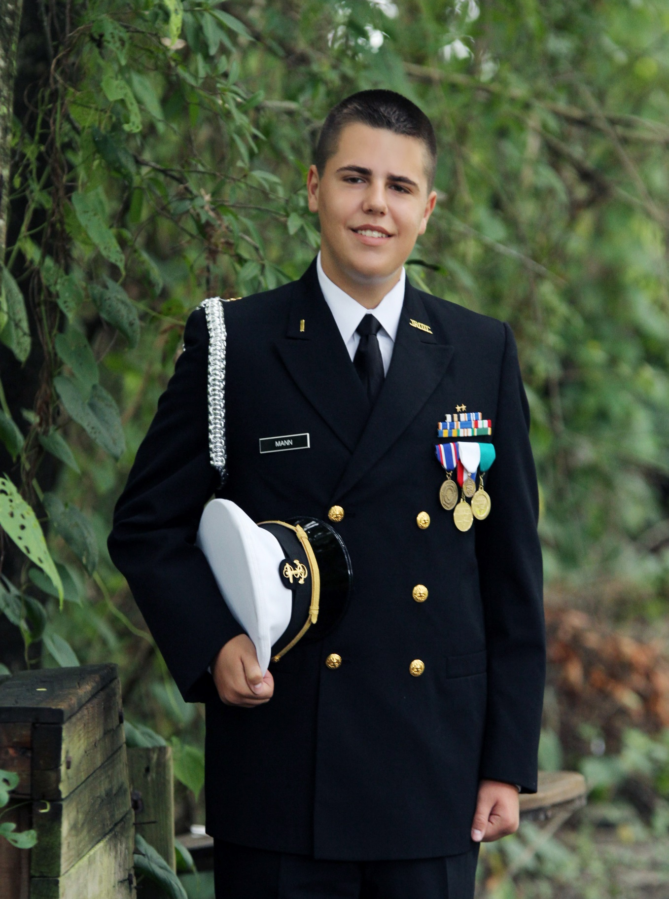
W
My reason: We are in a HUMAN business

Slide 3
PURPOSE
DEVELOP MINDSET, SKILLSET, AND TOOLSET FOR HIGH – STAKES ENGAGEMENTS AS A SOCOM STAFF MEMBER OR OPERATOR.
”How can I be the most relevant person in the room?”
How we’ll play (Our Objectives):
Know your arena (Human Domain Framework)
Connect as if your life depends on it
ID Best Practices and Tools you can use right away
* We will examine our past to chart a course for your most relevant engagements

Slide 4
Human Engagement Issues SOCOM Staff Face…It’s hard to connect
What causes Command in-fighting tensions within my own J-Codes?
Why is there such suspicion, parochialism, and distrust when I am working in another agency or command?
Why do some Dept of State and Country Team Officials view SOF as “Cowboys” despite consistent SOF performance?
How can I persuade other commands and agencies that I am a relevant contributor to their organization…and not a threat?
How do I overcome cultural and communications gaps within other organizations?
What else?
Should COL Ivy have apologized for leaving lunch early?

Slide 5
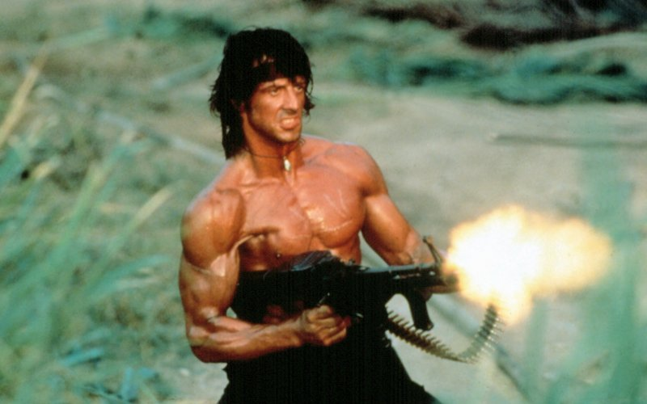
W
VSO was a concerted move from top-down kinetic focus to stability from the bottom-up
Notes:
There is a timeless gap between top and bottom. This gap is global.
Status and contract society are struggling.
Due to sustained trauma, many locals are trapped in inescapable shock between ‘fight’ and ’flight’
Degraded social systems and enhanced trauma create opportunities for outside agitators (violent extremists, criminals, transnational gangs)
Outside agitators are setting up their own societal systems in these areas – this spells big trouble for stabilty
ISIS is a very strong example of how this threat model plays out. (ISIS Video-No Respite)
Key Takeaway: Top-down solutions are failing everywhere by angering marginalized populations and giving strength to outside agitators who are taking refuge in these areas.

Slide 6
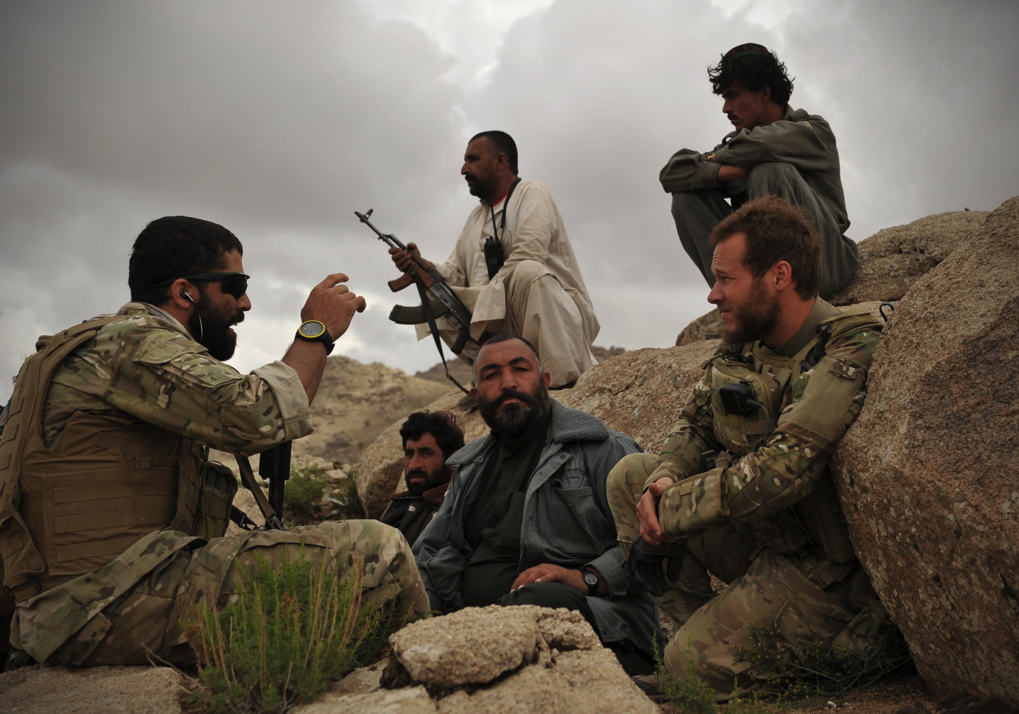
W
SO WHAT?!
What we learned as a SOF Community can serve you throughout SOF
Notes:
There is a timeless gap between top and bottom. This gap is global.
Status and contract society are struggling.
Due to sustained trauma, many locals are trapped in inescapable shock between ‘fight’ and ’flight’
Degraded social systems and enhanced trauma create opportunities for outside agitators (violent extremists, criminals, transnational gangs)
Outside agitators are setting up their own societal systems in these areas – this spells big trouble for stabilty
ISIS is a very strong example of how this threat model plays out. (ISIS Video-No Respite)
Key Takeaway: Top-down solutions are failing everywhere by angering marginalized populations and giving strength to outside agitators who are taking refuge in these areas.

Slide 7
W
PART 1 - KNOW YOUR ARENA
Notes:
There is a timeless gap between top and bottom. This gap is global.
Status and contract society are struggling.
Due to sustained trauma, many locals are trapped in inescapable shock between ‘fight’ and ’flight’
Degraded social systems and enhanced trauma create opportunities for outside agitators (violent extremists, criminals, transnational gangs)
Outside agitators are setting up their own societal systems in these areas – this spells big trouble for stabilty
ISIS is a very strong example of how this threat model plays out. (ISIS Video-No Respite)
Key Takeaway: Top-down solutions are failing everywhere by angering marginalized populations and giving strength to outside agitators who are taking refuge in these areas.

Slide 8
Current Threat Model
TOP
FORMAL/CONTRACT SOCIETY (30%)
SECURITY
ECON DEV
GOVERNANCE
TRUST GAP
CAPACITY GAP
SECURITY
PARTICIPATORY
ECON DEV
DISPUTE
RESOLUTION
AGITATORS
AGITATORS
BOTTOM
INFORMAL/STATUS SOCIETY (70%)

Slide 9
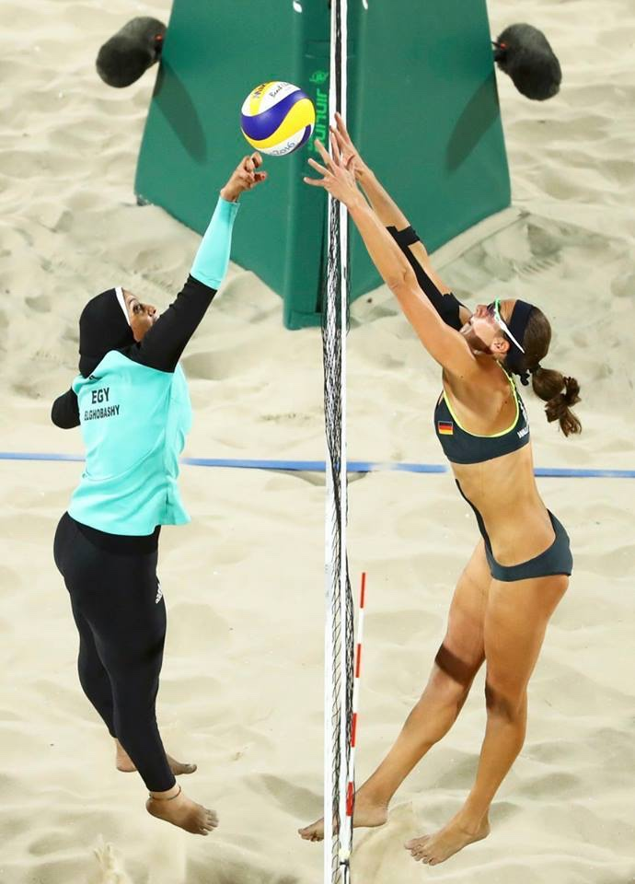
CLASH OF CLANS

Slide 10
CLASH OF CLANS
STATUS SOCIETY
CONTRACT SOCIETY
RESOURCE SCARCITY
ABUNDANCE
CLAN (IN-OUT GROUP)
INDIVIDUAL
HONOR/SHAME
ACHIEVMENT/GUILT
HOSPITALITY
GO-IT-ALONE
REVENGE
RULE OF LAW
FEUD
STATE CTRL OF VIOLENCE
RELATIONSHIPS
TRANSACTIONS
RESTORATIVE JUSTICE (ATONEMENT)
PUNITIVE JUSTICE
STORY/LISTENING/PHYSICALITY
BULLET POINTS/POWER POINT/ELEVATOR SPEECH
BONDING TRUST
BRIDGING TRUST
HOW DO I FEEL? HOW DOES SHE SEE ME?
WHAT DO I THINK?
EMOTION/PERCEPTION (RIGHT BRAIN)
LOGIC/REASON (LEFT BRAIN)
CONTRACT SOCIETY BEHAVIOR IN STATUS SOCIETY OFTEN CAUSES VISCERAL REJECTION

Slide 11
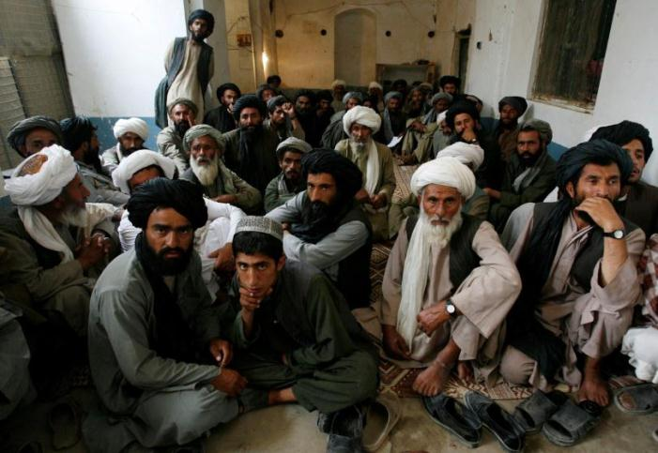
THIS IS TAMPA SARGE…NOT AFGHANISTAN
Notes:
1. This horrorism while effective short term, creates fissures in clan society. 2. Clans and tribes don’t like this kind of behavior. They are very pragmatic. Think Appalacia or the Pecos. They will go along to survive but resist when the time is right.

Slide 12
We are cavemen…with briefcases
(-) Current
Heavy Contract Society
10%
(-) 20 Years
Information Revolution
CONTRACT SOCIETY
(AGENCIES, COMMANDS, EMBASSIES)
TALKING PTS/
PODIUMS/PP
(-) 120 Years
Industrial Revolution
ACHIEVMENT /GUILT
(-) 250 Years
Liberal Democracy
PUNITIVE
JUSTICE
(APOLOGY)
“WHAT DO
I THINK?”
(-) 5,000 Years
City States
INDIVIDUAL
GO-IT-ALONE
LOGIC
(-) 7,500 Years
Metal Tools
TRANSACTIONS
BRIDGING TRUST
(-) 10,000
Years
Language, Farming
Don’t forget
Your inner
mammal lives
Below the waterline:
-Serotonin
-Oxytocin
-Dopamine
-Cortisol
These chemicals
and our tribal
wiring will always
have their say in
what you and those around you are doing, thinking, & feeling.
For the next 15,000 yrs,
we will be more tribal than
contract
HONOR/SHAME
RESTORATIVE
JUSTICE
(ATONEMENT)
EMOTION
CLAN
IN-OUT
GROUP
X
RELATIONSHIPS
BONDING TRUST
(-) 25,000
Years
Time required for
Genetic adaptations to
Take hold
STORYPOWER
INTENTION/
PHYSICALITY/
ACTIVE
LISTENING
HOSPITALITY
90%
(-) 250,000
Years
Modern man
Iceberg Takeaways for your engagements
-When sh*t gets real, we get tribal
-Always consider the power of clan behavior
-Hospitality & Restoration
is powerful in inter-organizational work
-Put relationships before transactions
-Look for opportunities to restore relationships
-No matter how logical things appear, emotion is just below the waterline
“WHAT DO
I FEEL?”
STATUS/TRIBAL
SOCIETY
(-) 1 MILLION
YEARS
Hominid Man

Slide 13
Human Engagement Issues SOCOM Staff Face… (“How do you transform 1 million years of tribal instinct into conscious engagement skill?”
What causes Command in-fighting tensions within my own J-Codes?
Why is there such suspicion, parochialism, and distrust when I am working in another agency or command?
Why do some Dept of State and Country Team Officials view SOF as “Cowboys” despite consistent SOF performance?
How can I persuade other commands and agencies that I am a relevant contributor to their organization…and not a threat?
How do I overcome cultural and communications gaps within other organizations?
Your challenges?
Should COL Ivy have apologized for leaving lunch early?

Slide 14
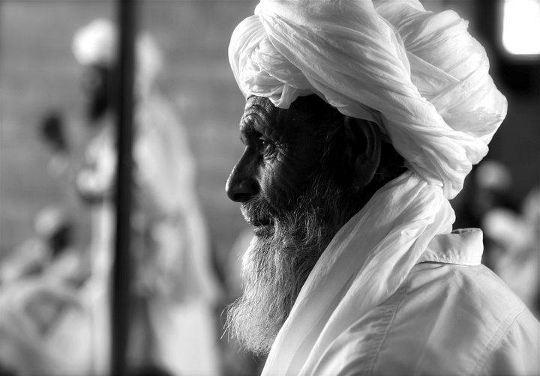
EXERCISE
Baseball and Tribes…
Marriage and Tribes…
When have you seen tribal behavior in your life or work and how did it impact your goals?

Slide 15
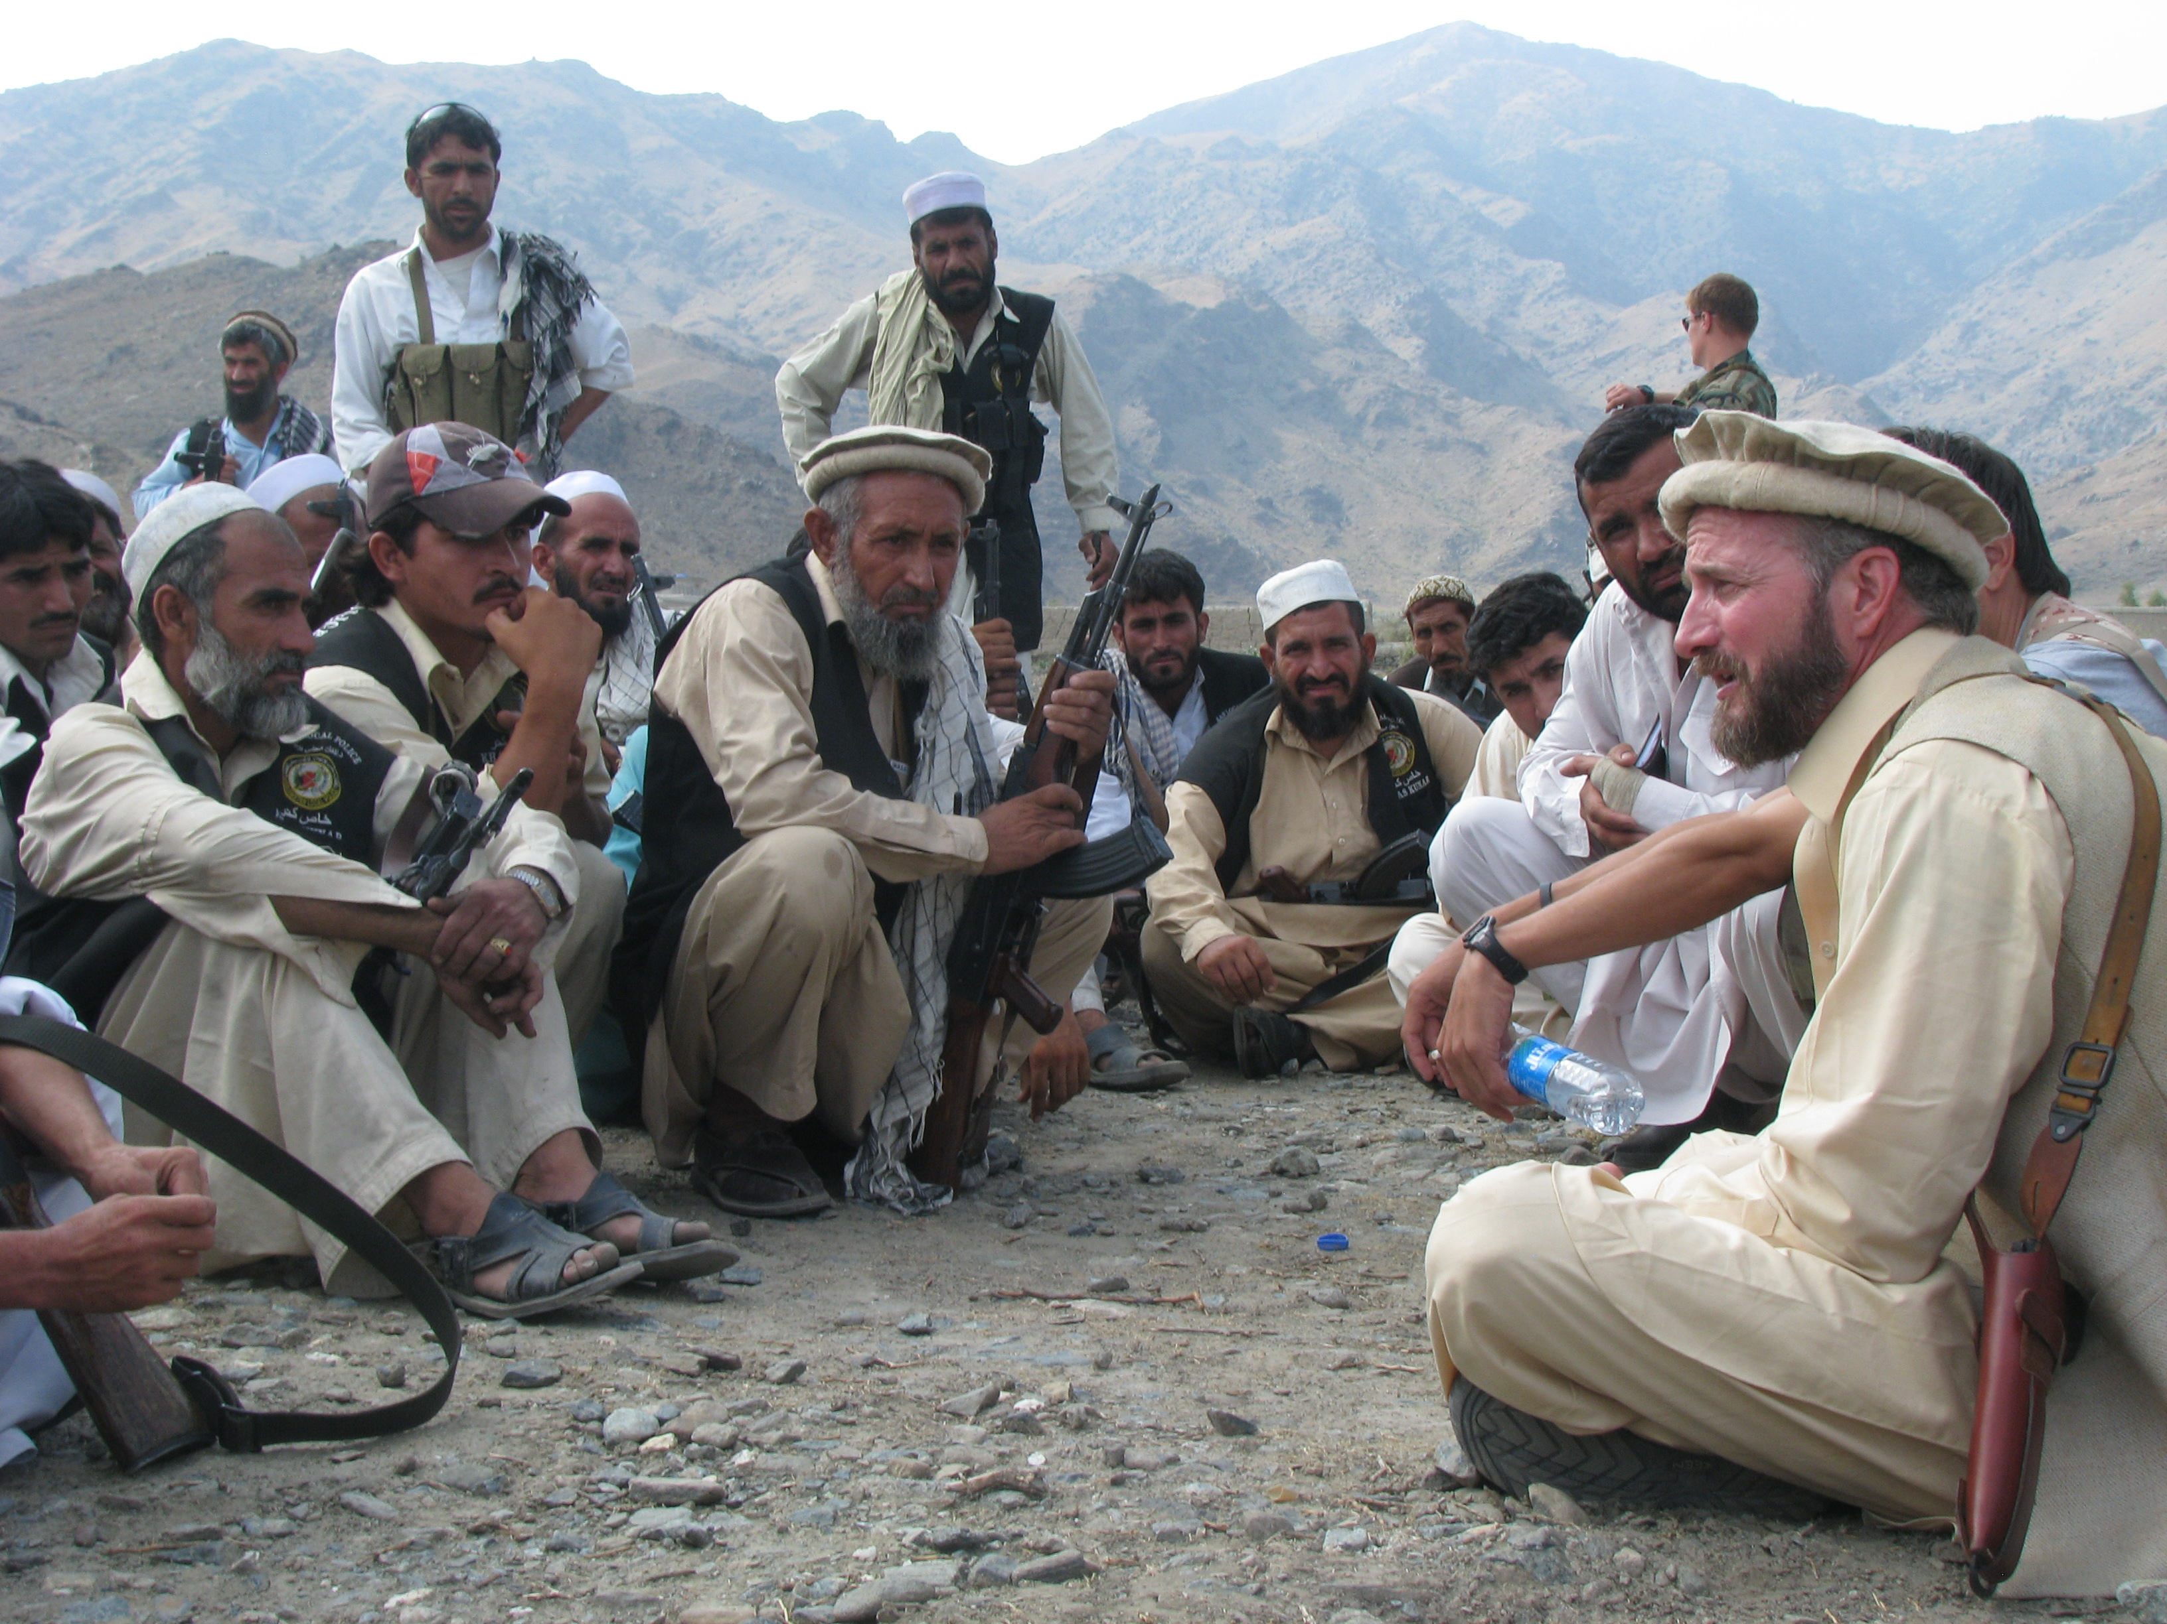
CONNECT AS IF YOUR LIFE DEPENDS ON IT

Slide 16
The secret sauce for SOF engagements…is Bridging Trust and Connecting People.
BRIDGING TRUST
CTR TEAM
10%
OUT
S
IN
LIMITED
RESOURCES
90%
BONDING TRUST
TRIBAL
PLACES

Slide 17
SOF TECHNIQUES FOR HIGH-IMPACT ENGAGEMENTS
Homework before legwork
Know their goals and yours (including your boss)
Set your intention early
Prepare and Rehearse for your engagement
Take the “emotional temperature” of the room (Stuart Diamond)
Make human connections through empathy and what is in their head/heart
Trade items that are valued differently (Know their blindspots and bring your capes to address them)
Speak clear and plain
Narrative Competence is critical (Tell your story and amplify others)
Active listening is a must
Avoid Powerpoint, but if you must use it…tell a story (Beyond Bullet Points)
Don’t over-reach in a single engagement (slow is smooth, smooth is fast)
The relationship is the ASSET (Put relationships before transactions)
Become a catalyst (bridge and connect)
Hand relationships off with care

Slide 18
PURPOSE
DEVELOP MINDSET, SKILLSET, AND TOOLSET FOR HIGH – STAKES ENGAGEMENTS AS A SOCOM STAFF MEMBER OR OPERATOR.
”How can I be the most relevant person in the room?”
“How do you transform 1 million years of tribal instinct into conscious engagement skill?”
How we’ll play (Our Objectives):
Know your arena (Human Domain Framework)
Connect as if your life depends on it
Put these Best Practices and Tools into use right away
* We will examine our past to chart a course for your most relevant engagements

Slide 19
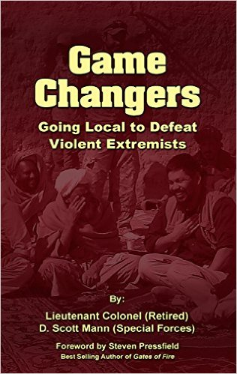
This requires changing the game
Contact Us:
Scott Mann
www.mannup.com
scott@mannup.com
-Giving away 5,000 copies to Special
Ops, IA, and Law Enforcement
-100% of Author Proceeds go to
Military Transition Efforts
(Mission America)
- Your Transition (Mission America)

